Slide 1



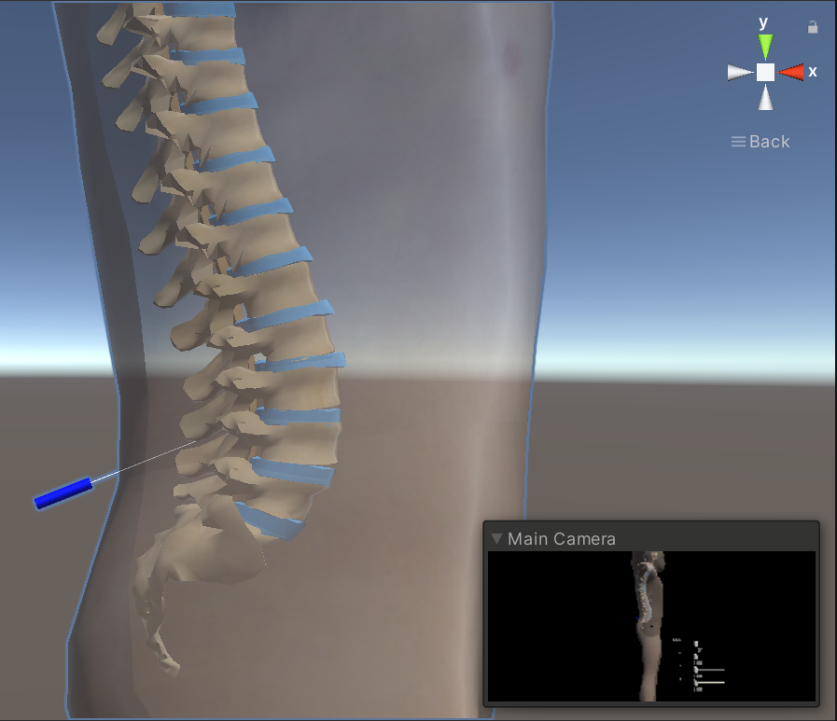
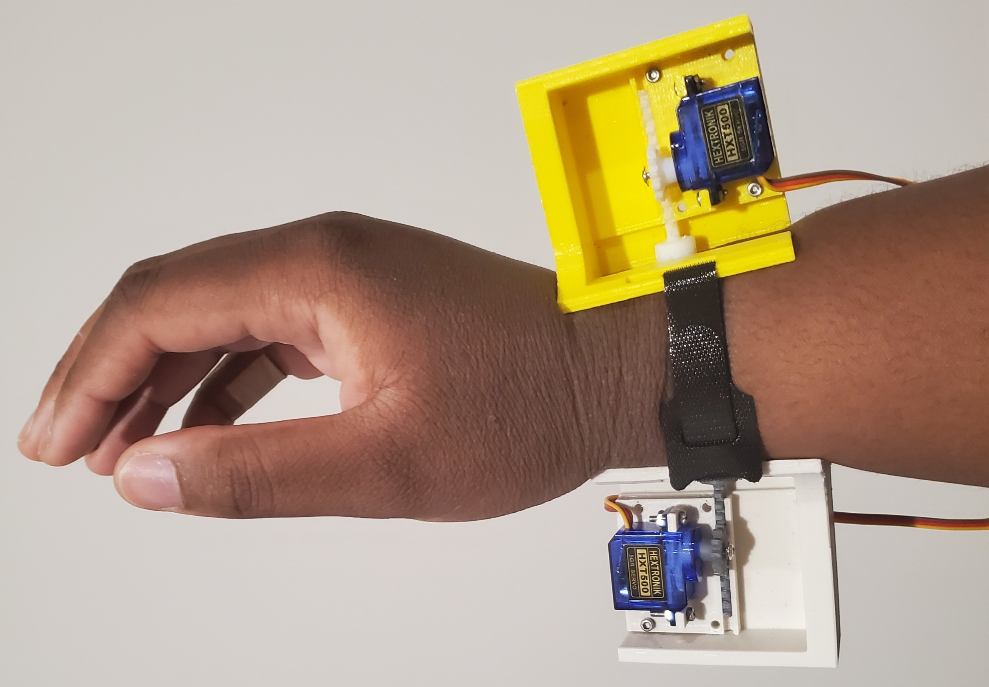
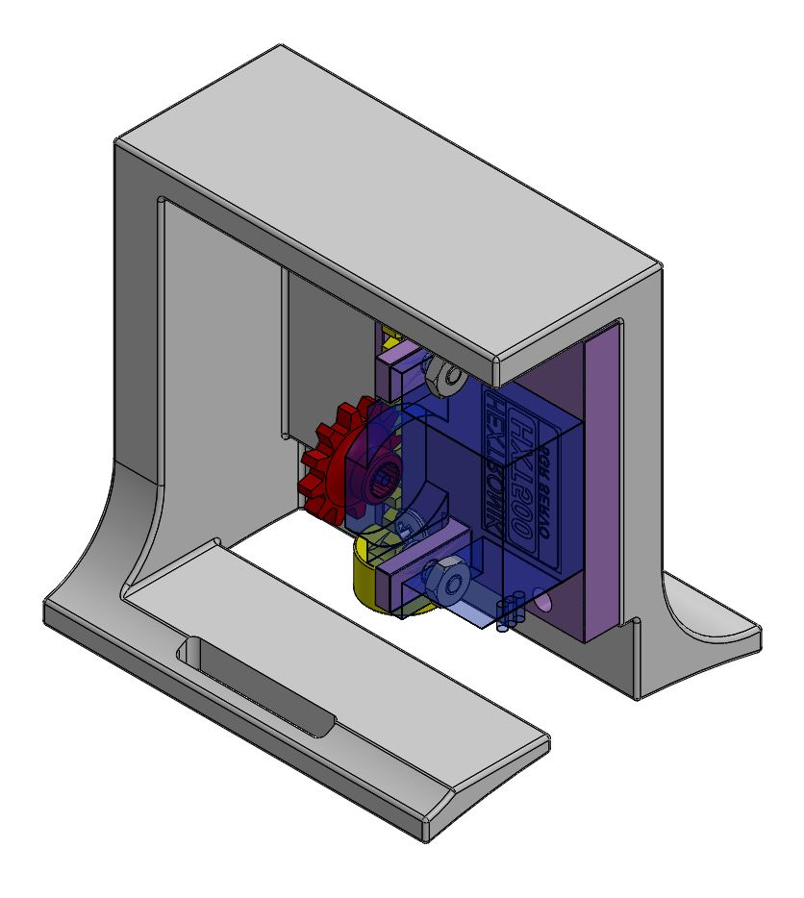
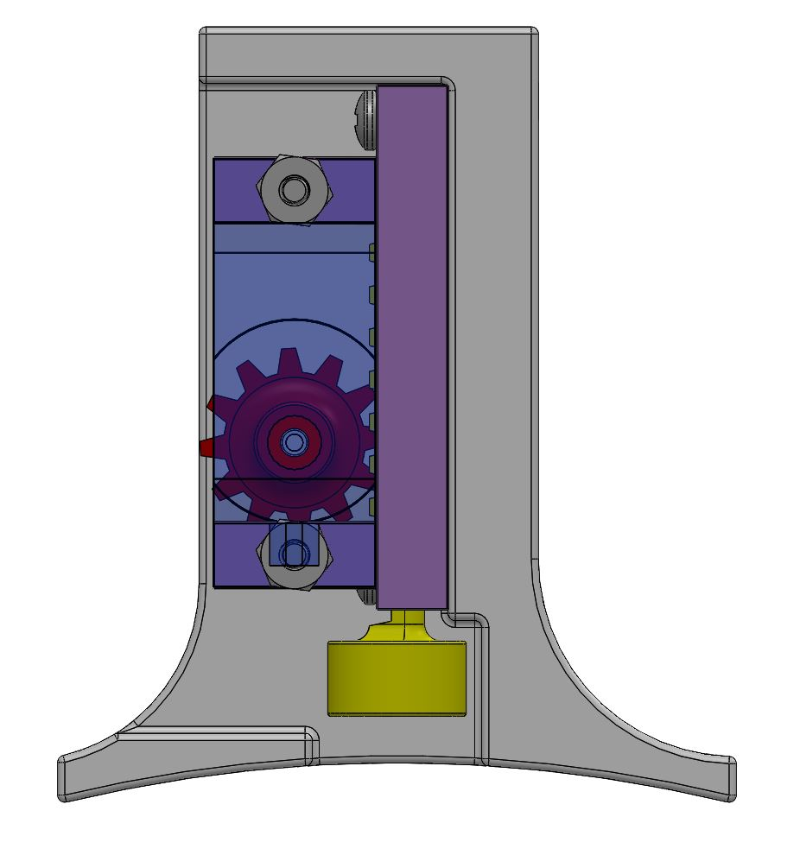
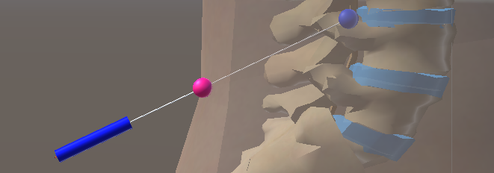



Mixed Reality Simulation for Training of
the Lumbar Puncture Procedure
Jasmin E. Palmer (jasminp@stanford.edu)
Department of Mechanical Engineering, Stanford University
Introduction
Virtual Environment
User Interface
Medical training involves performing procedures on inanimate proxies or human patients. However, these proxies are expensive and often “single-use” learning tools with limited applicability to human anatomy, and performing a procedure on a human patient while inexperienced can result in patient discomfort and complications. Additionally, there are procedures for which such proxies are not available for trainees. We developed a proxy for a lumbar puncture procedure via a mixed reality environment with haptic feedback. Medical simulations that provide haptic feedback can add value as a training alternative [1]. Here we present the design of a virtual environment and wearable device to provide haptic feedback relocated from the fingertips to the wrist. Previous tactile feedback devices used to interact with virtual objects provide forces directly to the fingertips to take advantage of their high mechanoreceptor density. However, these interactions limit the use of the hands in augmented reality scenarios [2]. When haptic feedback is relocated to the wrist, we propose that users will be able to manipulate physical tools while also receiving realistic programmable haptic feedback that displays interactions between the hand and a virtual or mixed reality environment [3] [4].
The virtual environment contains a model of human anatomy and a needle like those used by medical professionals.
The HoloLens 2’s hand tracking is used to move the needle and pose sliders. The user can use voice commands and buttons to explore the simulation.
Limitations
The virtual model provided does not have a complete model of human anatomy
The graphics quality of the HoloLens and Unity game engine required upscaling the needle to a size where it would be visible, therefore it is not representative of any needle gauge used for this procedure
Unity no longer supports non-convex mesh collision detection which causes some inaccuracy for the measurement of the god-objects’ position
Friction forces along the needle shaft were assumed to be negligible and therefore were not rendered
Assumed no deformation or bending of the needle
Assumed piercing force is only along the axis of the needle
Haptic Rendering
The interactions we were most interested in occurred at the needle tip. To render the haptic feedback, we used a modified version of the constraint-based god-object method developed by Zilles and Salisbury [5]. The anatomy was evaluated in 4 layers relating to the skin/muscle, bone, disc, and brain stem, each having their own respective god-objects. The needle’s haptic interaction point (HIP) was located at the needle tip. The interaction force is modeled as consisting of two main components: a piercing force at the needle tip and a component acting in the direction of the relative velocity between the needle and anatomy. The latter acts as the friction force along the surface of the needle. The piercing force for each god-object-HIP pair is modeled as a linear massless spring and is calculated by Hooke’s Law. The friction forces on the needle surface were assumed to be negligible.
References
[1] TR Coles, D Meglan, NW John. The Role of Haptics in Medical Training Simulators: A Survey of the State of the Art. IEEE Transactions on Haptics, 4(1):51–66, 2011.
[2] SB Schorr, AM Okamura. Fingertip Tactile Devices for Virtual Object Manipulation and Exploration. Proceedings of the 2017 CHI Conference on Human Factors in Computing Systems, pp. 3115–3119, 2017.
[3] M Sarac, AM Okamura, M Di Luca. Effects of Haptic Feedback on the Wrist during Virtual Manipulation. IEEE Haptics Symposium, Work-in-Progress Paper, 2020. Online: https://arxiv.org/abs/1911.02104.
[4] M Sarac, AM Okamura, M Di Luca. Haptic Sketches on the Arm for Manipulation in Virtual Reality. IEEE World Haptics Conference, Work-in-Progress Paper, 2018. Online: https://arxiv.org/abs/1911.08528.
[5] Zilles, C. B., & Salisbury, J. K. (1994, November). A constraint-based god-object method for haptic display. In ASME Haptic Interfaces for Virtual Environment and Teleoperator Systems (Vol. 1, No. 1, pp. 149-150).
Device Design
To display simulated interaction forces, a 1-degree-of-freedom wrist-worn tactile haptic device provides skin deformation normal to the user’s wrist via a tactor connected to a rack and pinion and driven by a servo motor. The user wears one of these devices on the ventral side of their wrist and another on the dorsal side. Each device provides equal pressure to each side of the wrist to simulate the normal forces acting at the tip of the needle.
Acknowledgements
Dorsal
$$\vec{F} =k\vec{d}$$
This work was supported in part by the CHARM Lab, the IMMERS Lab, the National Science Foundation Graduate Research Program, the GEM Fellowship, and
Army grant W81XWH-20-C-0008 in
Collaboration with Triton Systems, Inc.
$$\vec{d}$$
Ventral

